Slide 1
Storytelling as advocacy:
A Nonprofit Leader’s Guide to Influence
Shaylene Smith, JD, CNP
Executive Director, Blue River Arts Council

Slide 2

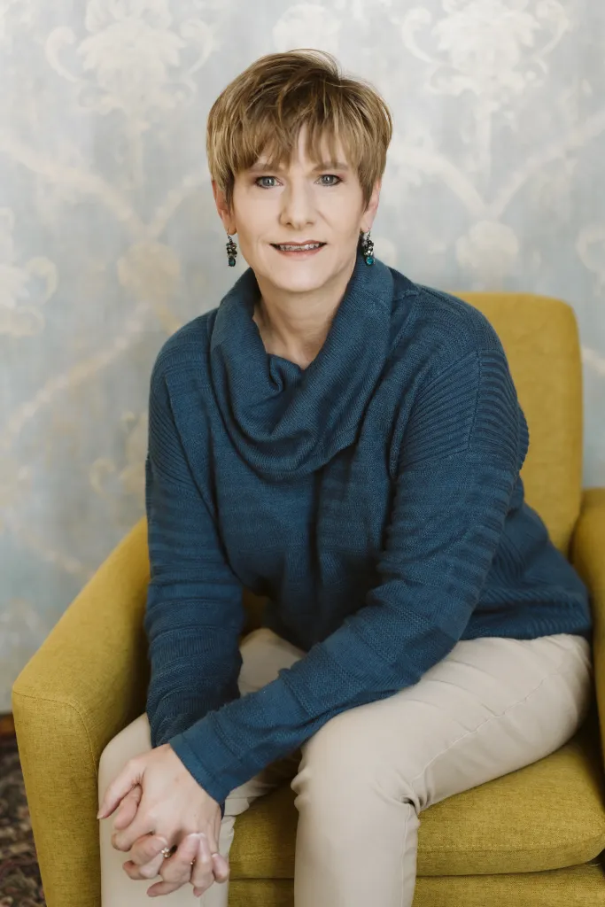
DISCLOSURE
I have been a general practice attorney for more than 30 years and built or assisted many nonprofit organizations.
I am also a tax practitioner with both PTIN and CAF authorization with the IRS.
Much of what we will be talking about today is relevant to all 501(c)(3) organizations, but I am only licensed to practice law in Nebraska.
If something in this presentation encourages you to advocate or even lobby in a new or different way, I recommend seeking local counsel if you have any questions about this work as it relates to your mission.

Slide 3
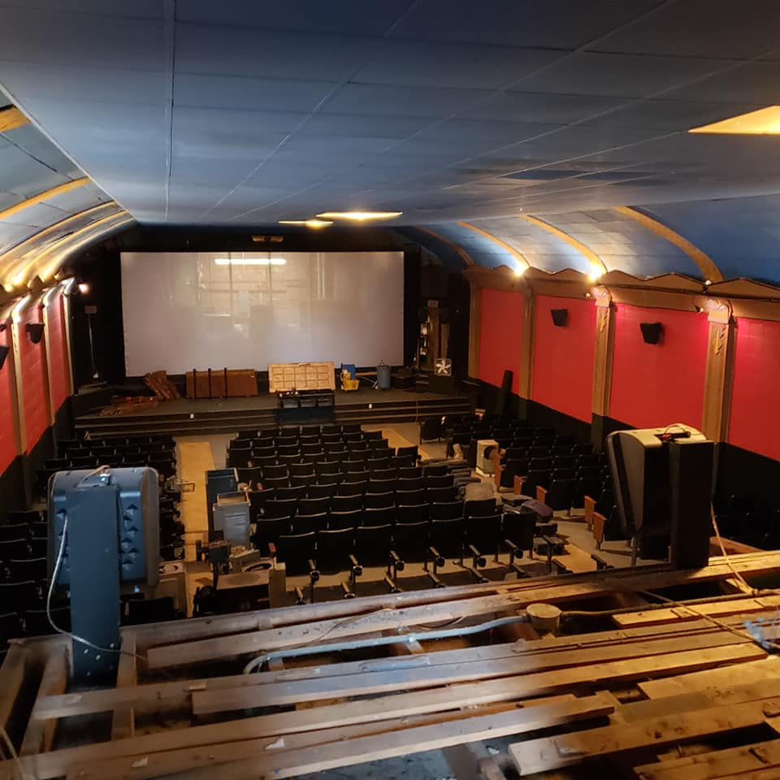
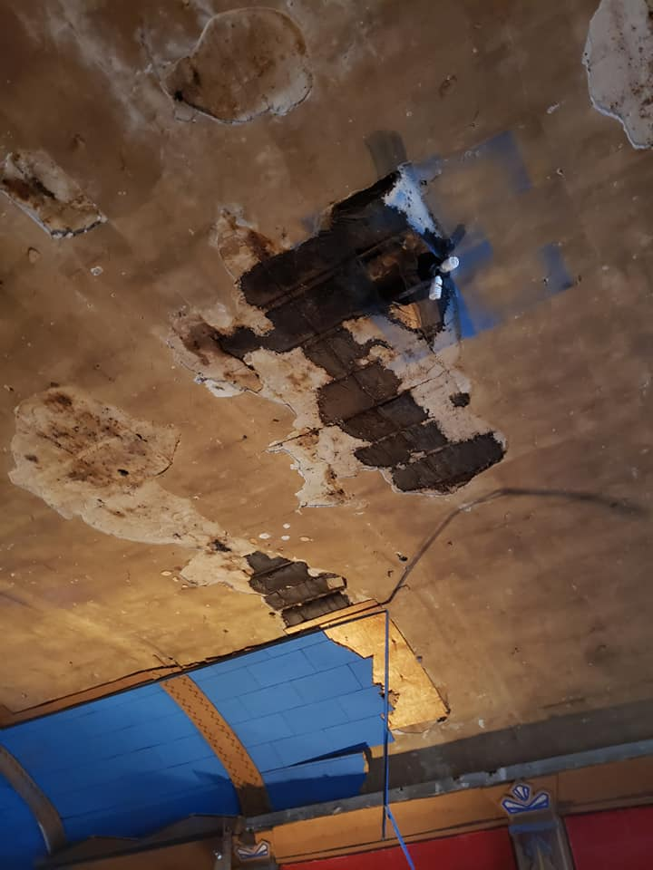

CLOSED 2018 ISIS THEATRE

Slide 4
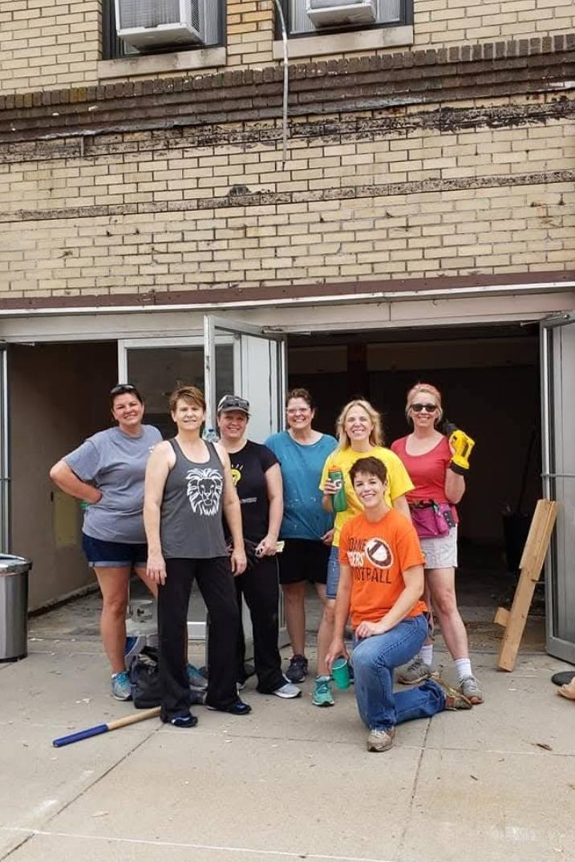
BLUE RIVER ARTS COUNCIL
Founded when we lost the only theatre in our county in southeast Nebraska. We received IRS 501(c)(3) status in February 2019. The City bought the vacant building, and we started planning renovations.
#resurrectthegoddess

Slide 5
RENOVATION REALITY
2019 ​
Demolition of entry
Asbestos abatement
Redesign logo
Retain Architect
Plans and budget
​
2020
Leap Around Crete
Capital Campaign is launched 2/29/2020
First COVID deaths in our community three weeks later
Project suspended
2021​
Start grant applications
Shaylene gets CNP
Prices skyrocket
Latent damage is found

Slide 6
WE STARTED TELLING OUR STORY
FUNDING?!?
MISSION
VISION
VALUES

Slide 7
“In order to be tax-exempt under 501( c)(3) of the Internal Revenue Code, an organization . . . May not be an action organization, i.e., it may not attempt to influence legislation as a substantial part of it’s activities and it may not participate in any campaigning activity for or against political candidates.”
- IRS.GOV

Slide 8
AT RISK:
Losing your nonprofit status
Excise tax penalty

Slide 9
STORY #1
TESTIFYING BEFORE THE NEBRASKA LEGISLATURE
SHOVEL-READY RECOVERY ACT
LB 566

Slide 10


Slide 11
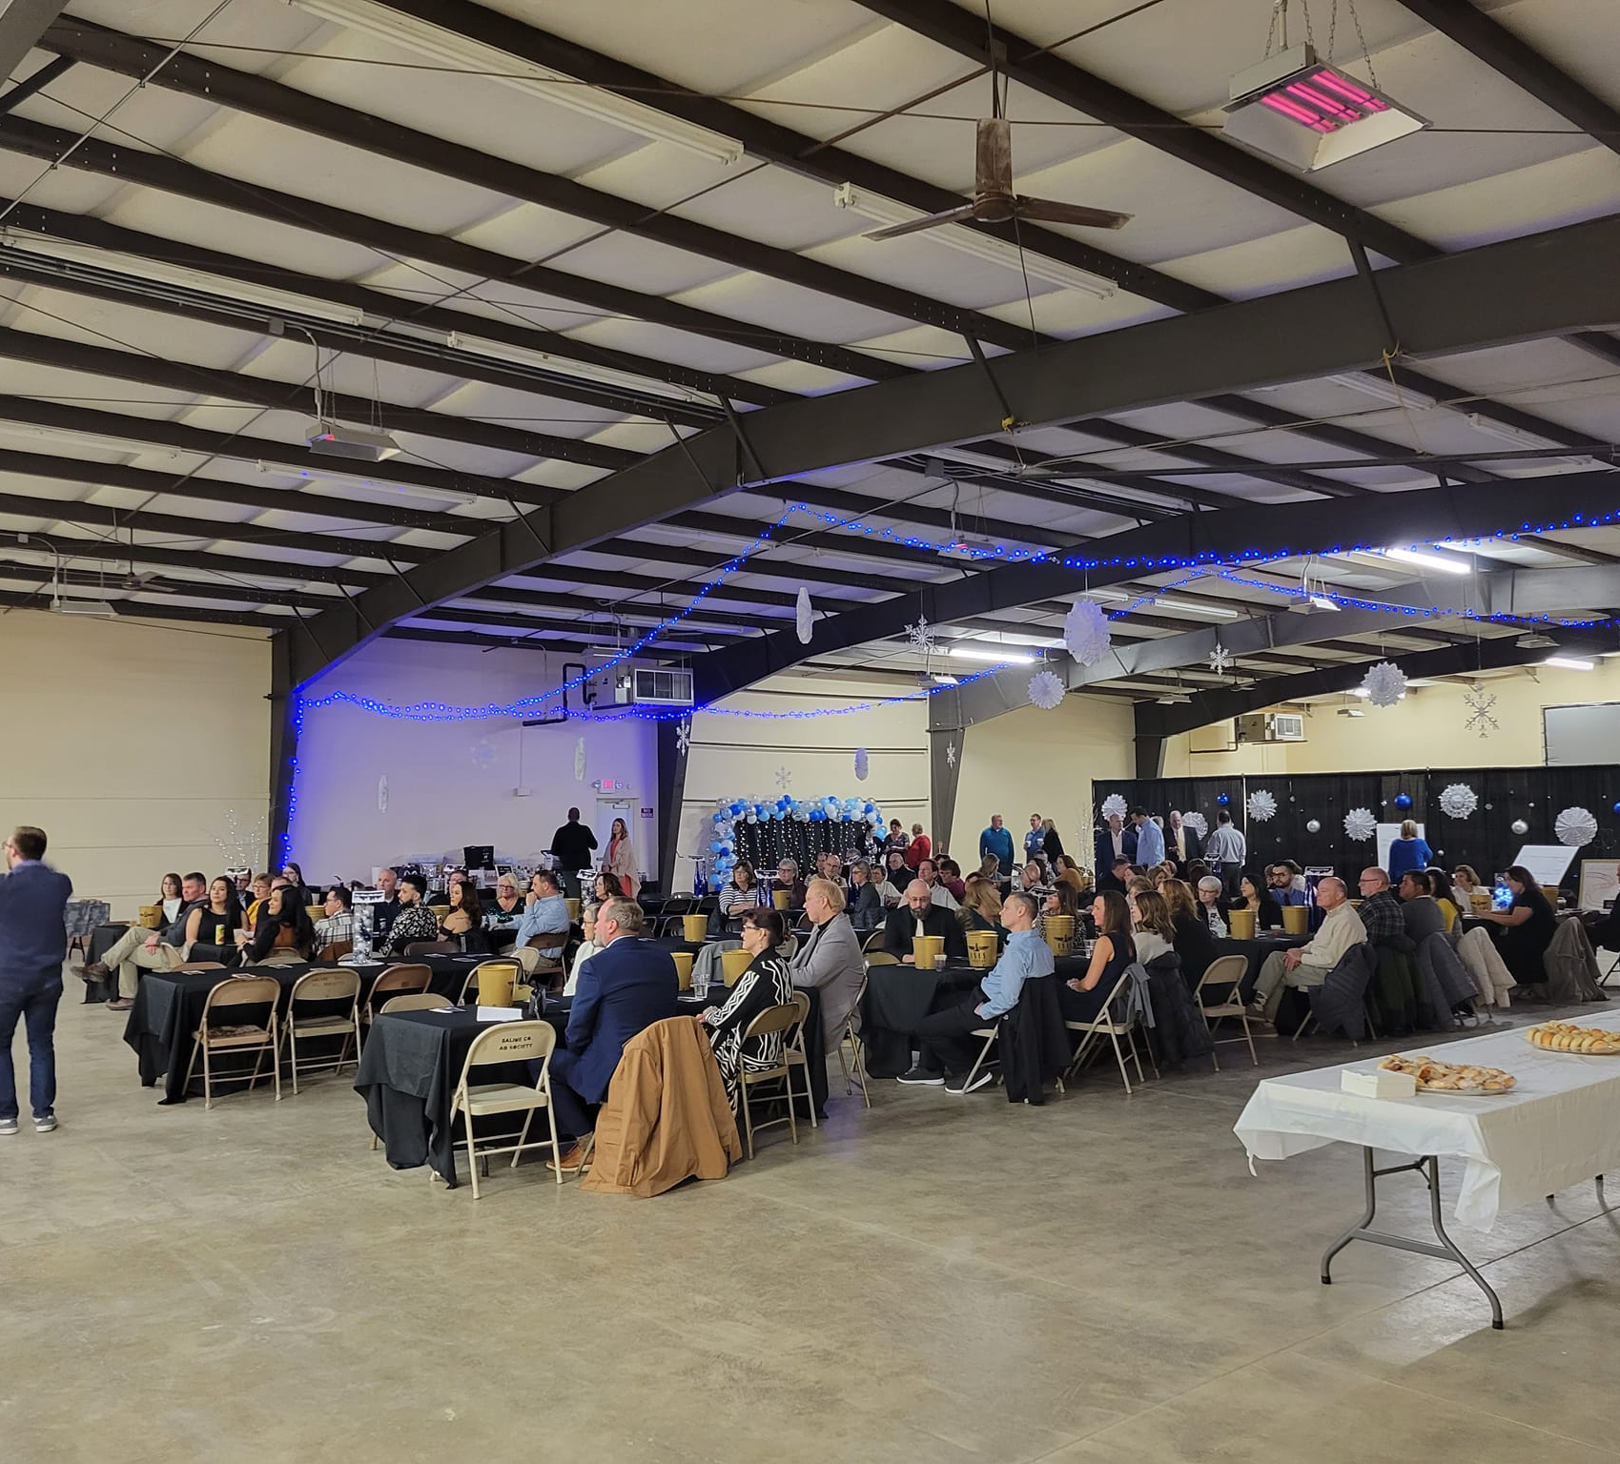
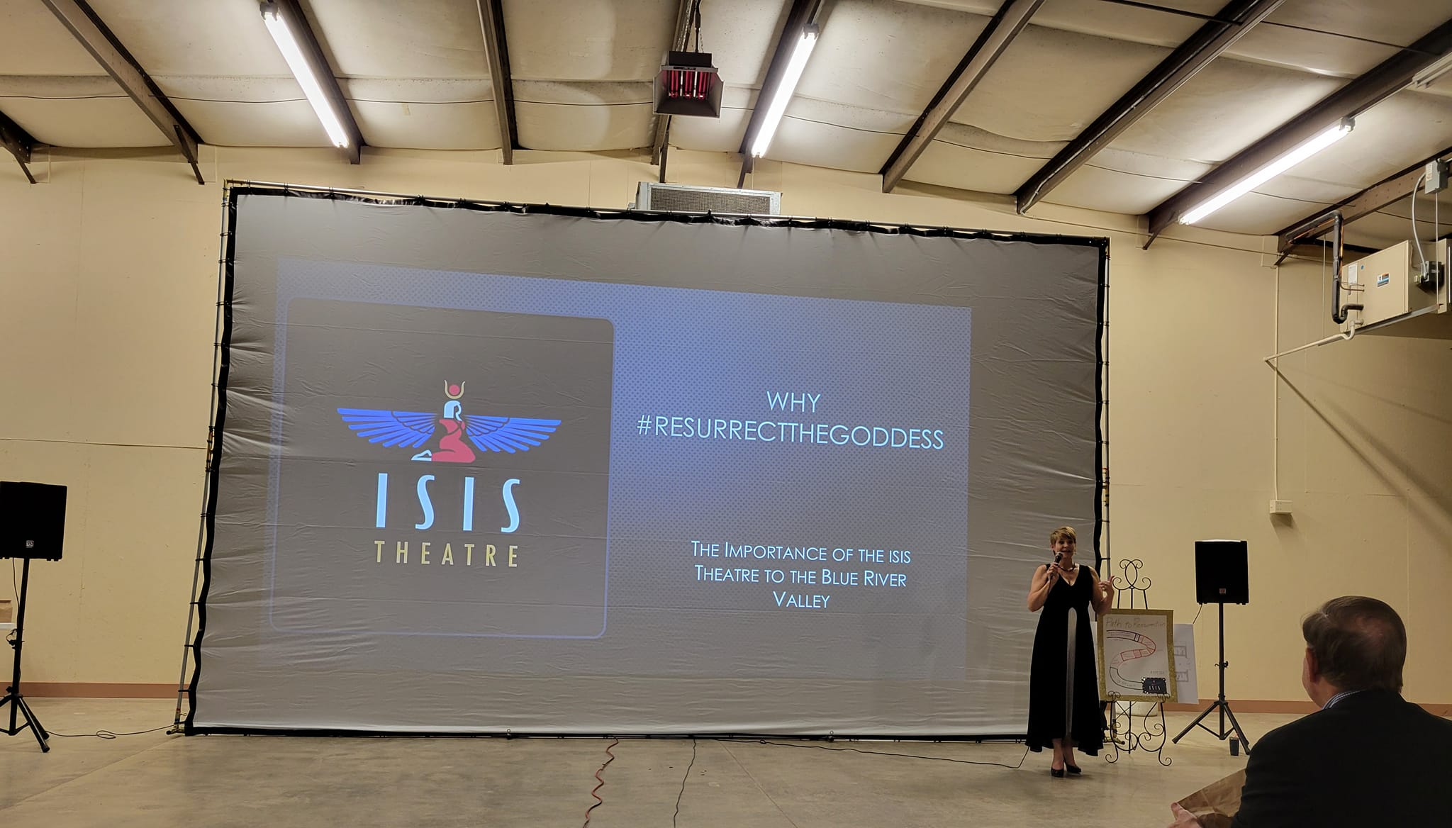
STORY #2 SNOWBALL GALA
CALLING OUT CITY OFFICIALS

Slide 12
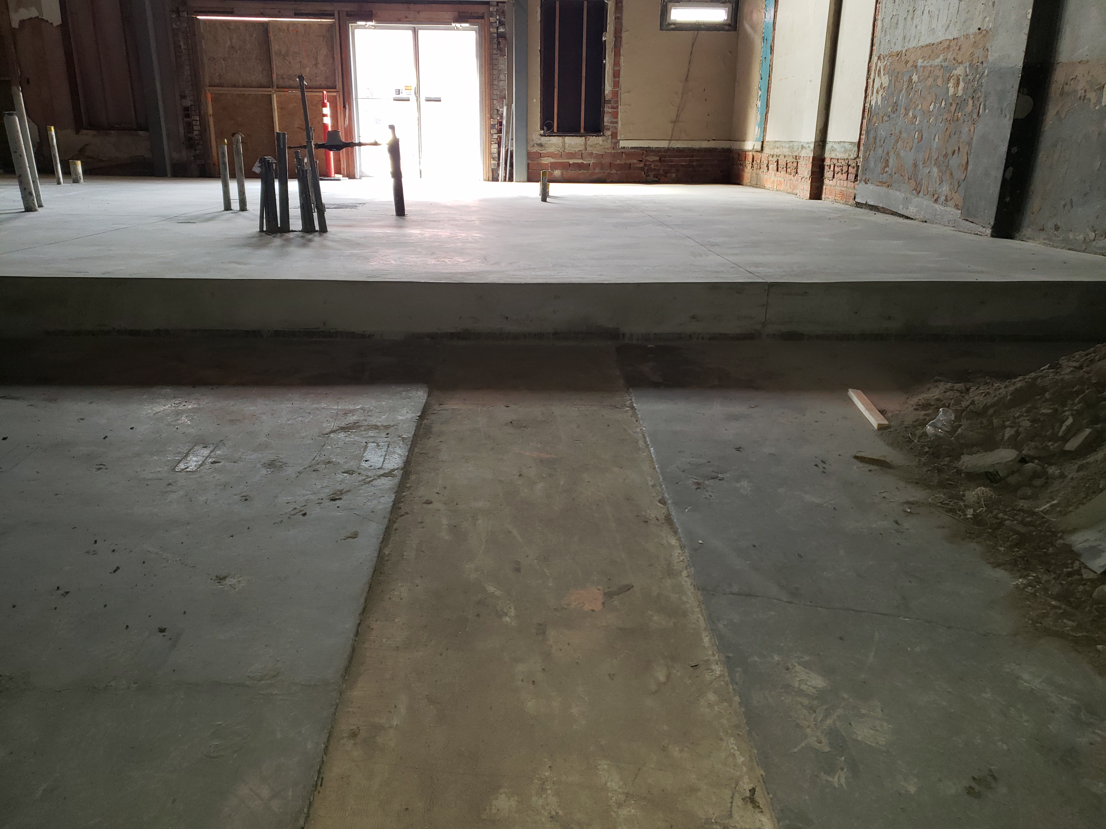
STORY #3
CHALLENGING
STATE FIRE
MARSHAL
WRITTEN LETTER

Slide 13
INFLUENCE: AREAS OF CONCERN
1. POLITICAL INTERVENTION
Not allowed to endorse candidate – HARD NO
Cannot involve candidates in any way that would show favoritism
Can only educate the public as to candidates positions IF ALL are invited and treated in a fair and equitable manner and a broad variety of topics are addressed
ALLOWED:
DEBATES, ISSUE SUMMARIES

Slide 14
2. LOBBYING
LOBBYING IS ALLOWED!!
Speaking directly to a specific bill and requesting a specific result or publicly stating a position with regard to pending legislation or act of any governing body
DIRECT – Speaking to elected officials
INDIRECT – Trying to influence public reaction
SUBJECT TO LIMITATIONS

Slide 15
SUBSTANTIAL PART TEST | EXPENDITURES TEST
Grey test depending on facts Case law tends to land around 5% of the organization’s budget Takes time of employees AND volunteers into account so you have to determine a monetary value for their labor Add time to the expenses paid No brightline rule!! EXAMPLE: $2,500 +/- for a $50,000 Budget | MUST make election before the work via Form 5768 Provides clear financial limitations Volunteer time is NOT included 20% of first $500,000 15% of next $500,000 10% of next $500,000 $225,000 for a $1,500,000 Budget GRASSROOTS LIMITATION = 25%

Slide 16
#3 ADVOCACY
NOT LOBBYING - NOT subject to limitations
Educating others on the issues that are important to your organization or those you serve
Does not involve any candidate OR any specific legislation
STORY TELLING

Slide 17
Research and share results
Express viewpoints on
generalized issues
Advocate before rule makers
(as opposed to law makers)
ISSUE-related mail, radio, tv

Slide 18

Impact litigation:
Plaintiff or Amicus
Engage online to share
information

Slide 19

WHY IS ADVOCACY ENCOURAGED?

Slide 20
STORY #3 - FIRE MARSHAL
NOT LOBBYING
A rule-making entity, not policy-making

Slide 21
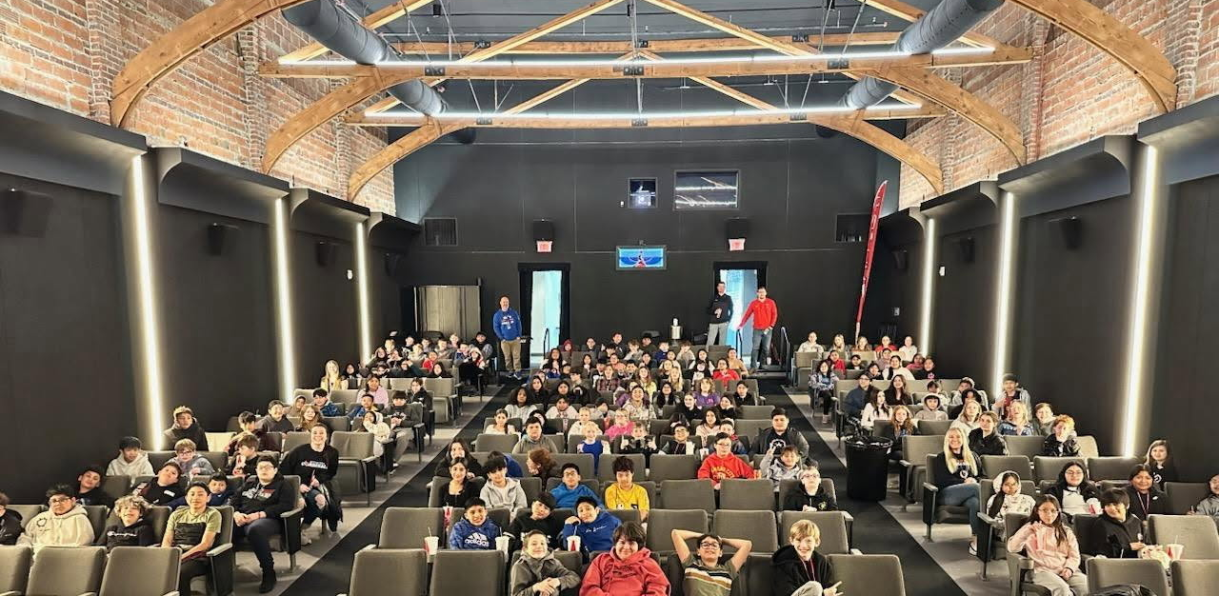

Slide 22

STORY #2
POSTCARDS
AT OUR GALA

Slide 23
LOBBYING or EDUCATION?
Substantial part test – Budget that year was $100,000
$50 for postcards, 2 hours of President’s time
IF Expenditures Test – 25% Grassroots Limitation Applies
We got a legal opinion in advance

Slide 24
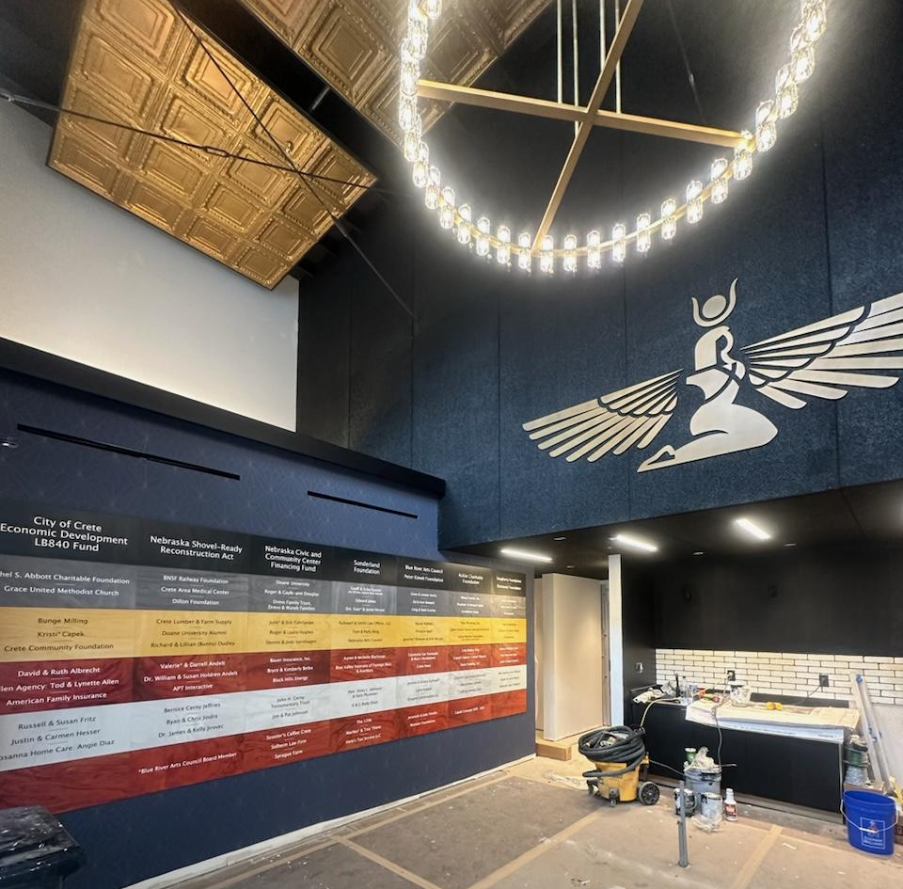
A $355,000 Economic
Development Grant WAS Awarded LATER
THAT YEAR

Slide 25
STORY #1 - TESTIFYING

Slide 26
Shovel-Ready RECOVERY ACT
2020
We started telling our story after our Mission, Vision, & Values were reset
2021
Shay asked to testify
The Legislature passed LB 566, allocated $115,000,000
July 2024
Isis Theatre Reopens after $2,200,000 renovation
2022
The State awarded grants to 76 different projects around Nebraska
2023
BRAC receives $333,500

Slide 27
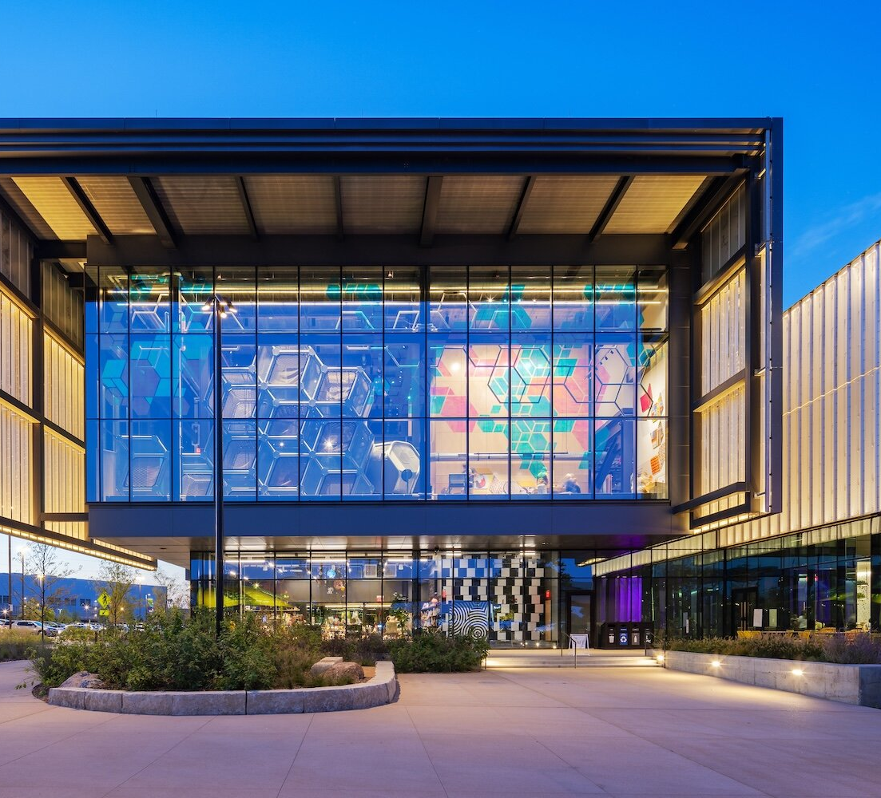
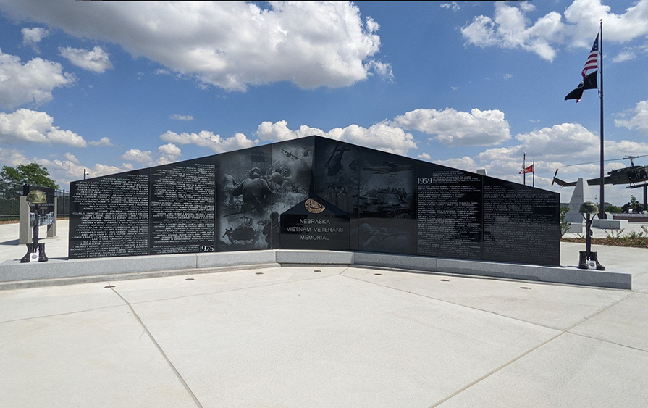
Left: Kiewit Luminarium - Omaha
Right: Nebraska Vietnam
Veteran’s Memorial - Papillion

Slide 28
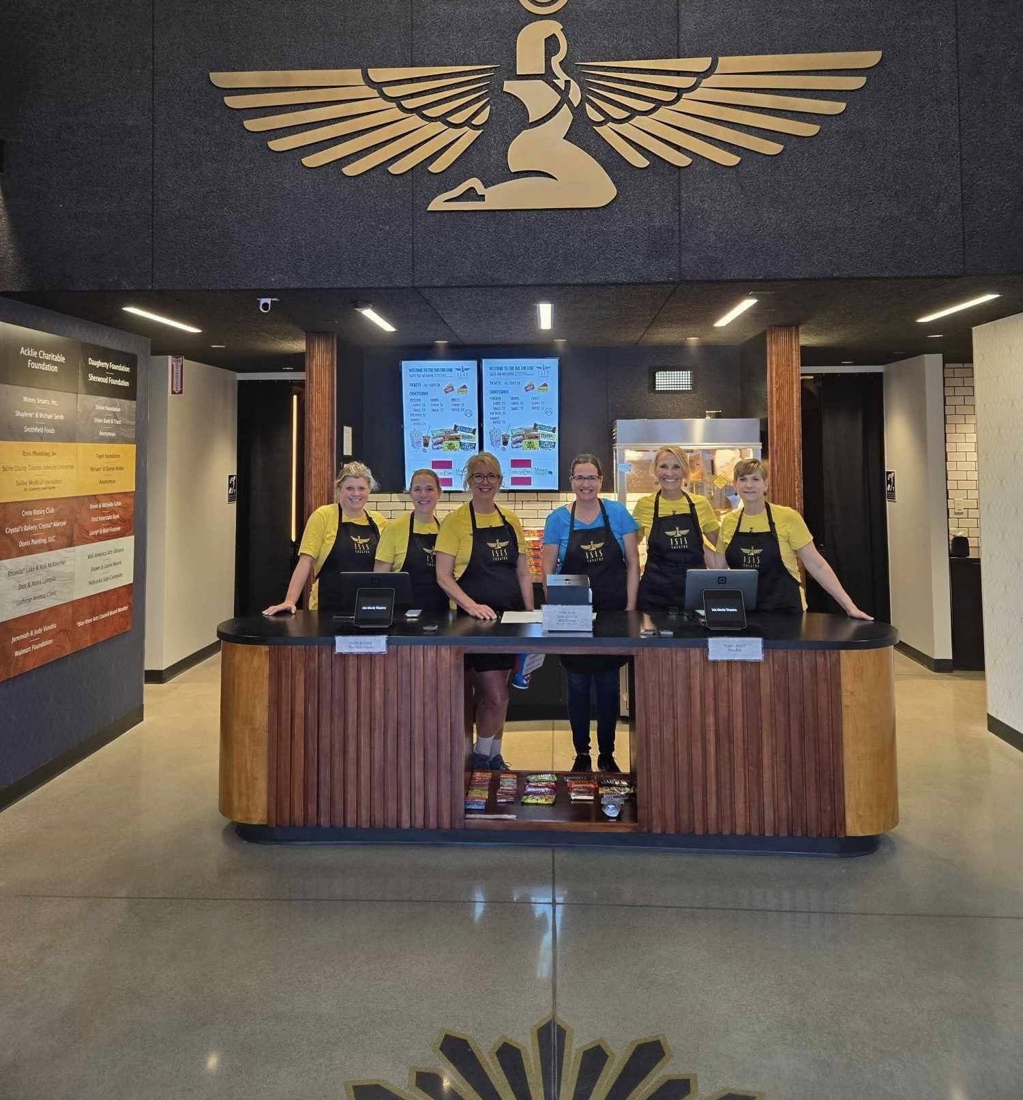

Slide 29
Shaylene Smith
Blue River Arts Council
Crete, Nebraska
shaylenek@hotmail.com
(402) 641-6599

